Slide 1

Title: Enhancing Low-Contrast Images
Subtitle: Linear, Log, and Exponential Contrast Enhancement
Name- Sanat Kumar Agrawal(22B3919), Jatin Kumar(22B3922), Saarthak Krishan(22B3959), Aditya Singh(22B3964)
Date- 30/11/2023

Slide 2
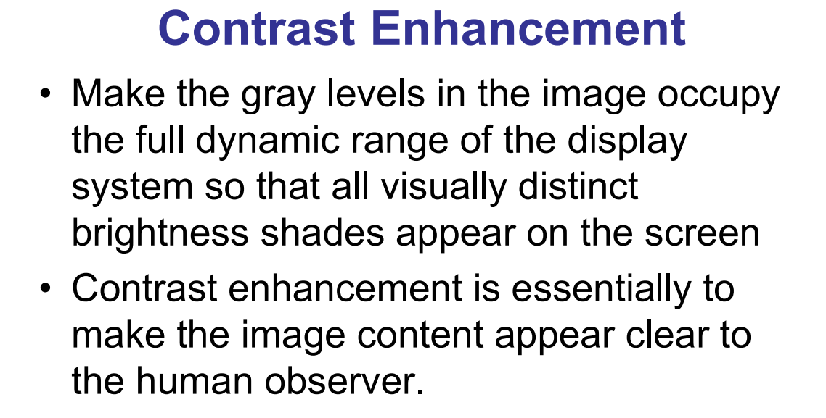
Introduction
Low-contrast images diminish visual clarity, impacting fields like medicine, analysis, and photography. Contrast enhancement is pivotal in image processing, revitalizing images by amplifying tonal differences. This presentation aims to explore and demonstrate linear, logarithmic, and exponential contrast enhancement techniques, showcasing their transformative abilities.

Slide 3
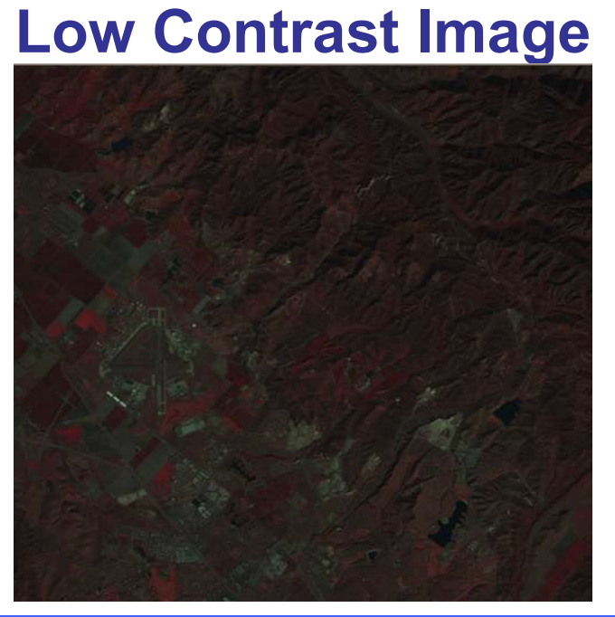
Low-Contrast Image Example
Here's the original low-contrast image illustrating reduced tonal variation. Challenges include reduced detail and clarity, making interpretation difficult. This emphasizes the necessity for enhancement techniques to restore visual richness and improve interpretability.

Slide 4
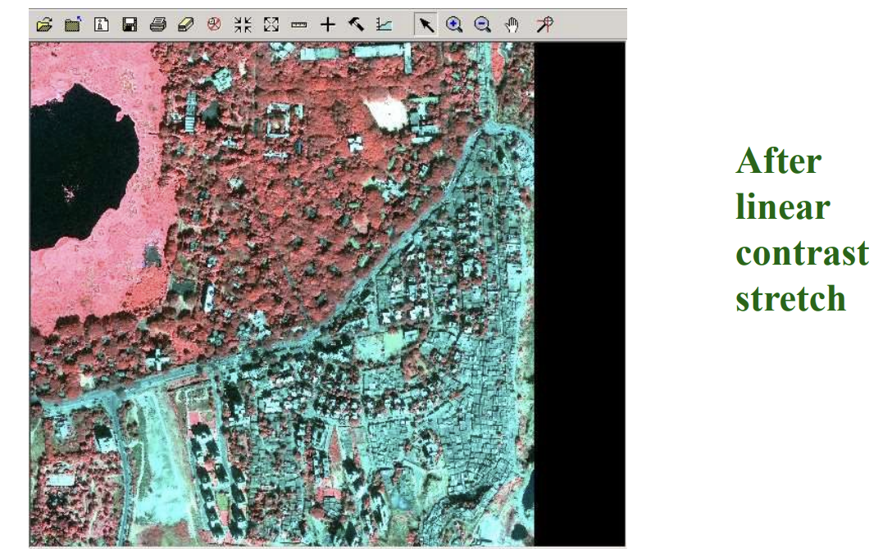
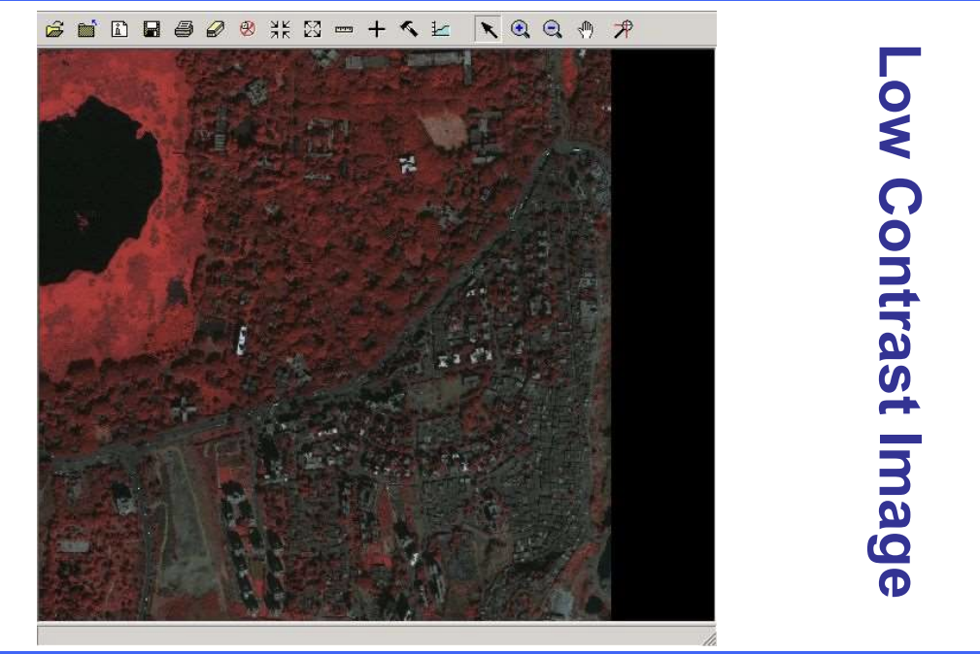
Linear Contrast Enhancement
Linear contrast enhancement amplifies tonal variation by stretching the pixel intensity range. This method employs contrast stretching, expanding the range of pixel values. A visual comparison showcases how this technique enriches the image, yet it might lead to saturation or loss of detail in extreme cases.

Slide 5
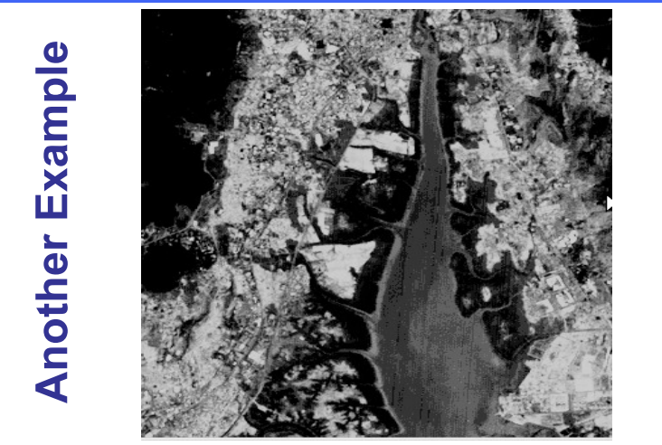
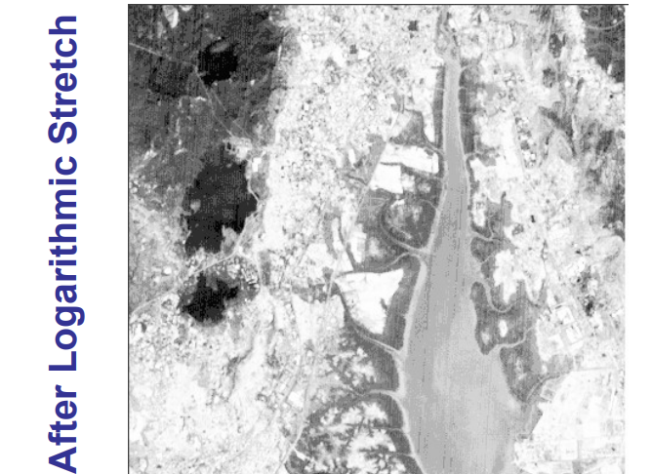
Log Contrast
Enhancement
Logarithmic enhancement accentuates tonal differences by applying logarithmic functions to pixel values. Unlike linear methods, log enhancement suits images with extreme tonal variations. While effectively enhancing darker areas, it might result in overly brightening lighter areas, potentially losing subtle details.

Slide 6
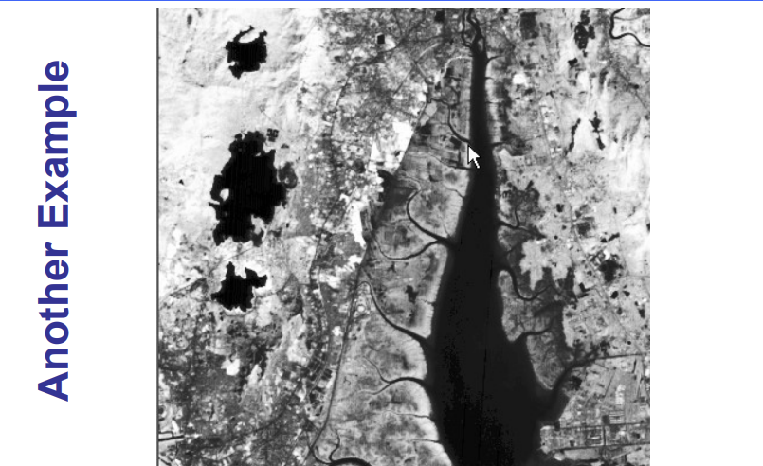
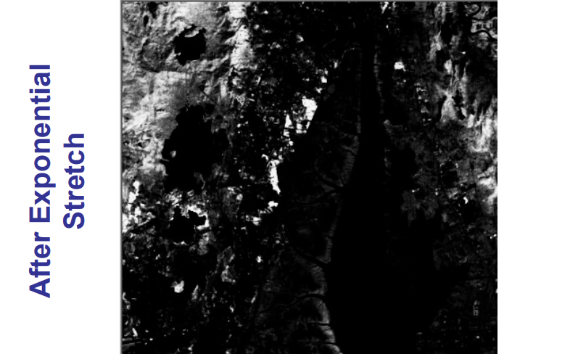
Exponential Contrast Enhancement
Exponential enhancement employs mathematical formulas to manipulate pixel values, offering versatile tonal adjustments. Its application revitalizes low-contrast images, highlighting details without overemphasizing extremes. However, it requires careful parameter selection to prevent unnatural results.

Slide 7
Comparative Analysis
Comparing the three techniques reveals distinct outcomes and effectiveness. Linear enhancement best suits images with uniform tonal distribution, while logarithmic and exponential methods excel in extreme tonal variations. Each technique has its applicability based on image characteristics.

Slide 8
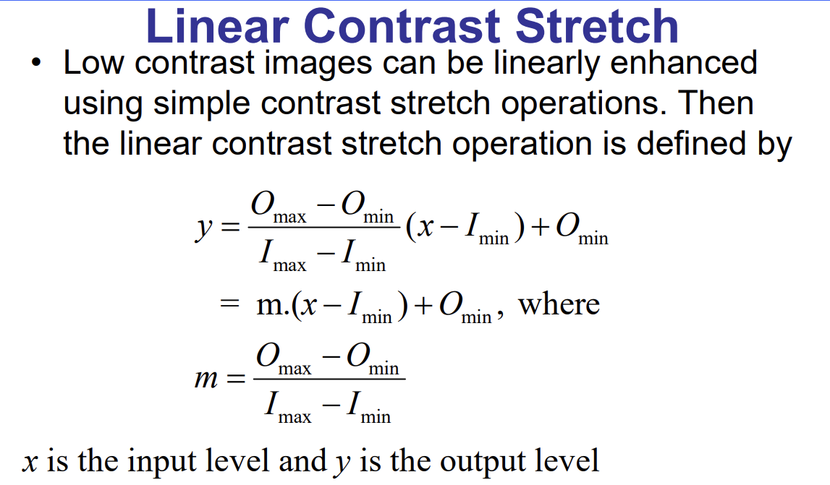
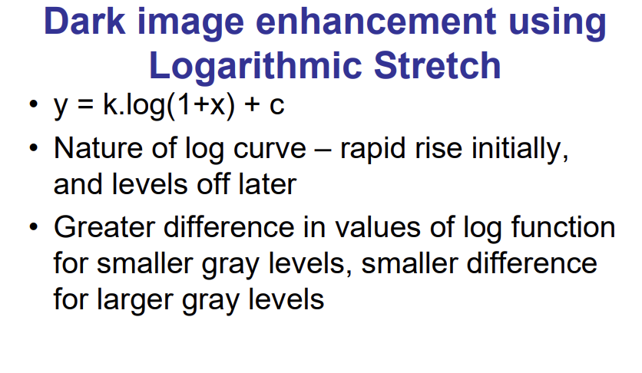
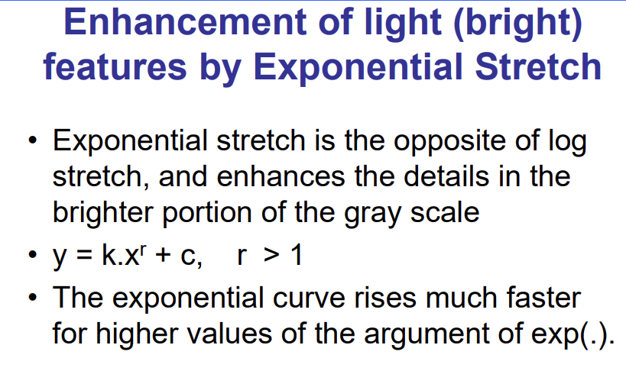

Slide 9
Applications and Use Cases
Contrast enhancement finds applications in medical imaging, satellite analysis, and photography. It enhances diagnostic accuracy in medical images, aids in terrain analysis via satellites, and improves visual appeal in photography. These techniques play a crucial role in extracting meaningful information from visual data.

Slide 10
Conclusion
In conclusion, contrast enhancement techniques play a vital role in image processing, rejuvenating low-contrast images for improved interpretability and visual quality. Acknowledging their significance across various domains, these methods offer invaluable tools for extracting crucial information from visual data. Thank you for your attention.

